Slide 1
WELCOME GOALIE
NEXT
This is your playbook

Slide 2
PREV
NEXT

Slide 3
Welcome to the game, Goalie! We're giving ourselves a big pat on the back for drafting you!
We know the first days and weeks at a new job can be nerve wracking; we've been there. Walking into an office full of Goalies can seem daunting. We can be a loud bunch, music wars are happening on the daily, there are nerf darts randomly whizzing by your head, and everyone seems to have a super weird nickname. It's hard enough learning one name for each person, but now you've got to learn two.
Rest easy. Pretty soon you'll feel like you've been here forever, and you'll be joining in on a riveting round of hypothetical discussions.
Speaking of ... you're walking in a forest and you find a black suitcase. Inside it holds $1,000,000 and a piece of paper stained in blood with a single word. "Don't". Would you take the suitcase home or leave it?
PREV
NEXT

Slide 4
READY POSITION
This is the fundamental position from which the game is played. You must be ready before you can run, block, tackle, etc.
awareness noun
aware·ness | ə-ˈwer-nəs
1: ability to know one’s strengths and weaknesses
2: ability to know one’s environment
dexterity noun
dex·ter·i·ty | dek-ˈster-ə-tē
: the fine-tuned control over one’s talents to succeed in an array of situations
focus noun
fo·cus | fōkəs
: the foundation on which all other values rely
passion noun
pas·sion | ˈpa-shən
: the powerhouse responsible for energy to achieve the monumental
sportsmanship noun
sports·man·ship | ˈsports-mən-ˌship
: respect for the game, the officials, and the other players.
See also: integrity
PREV
NEXT

Slide 5
When I arrived at The Goal in the Fall of 2016, I immediately fell in love with the company culture, the leadership, and the forward-thinking nature of the company. I thought to myself "I have finally found a home, somewhere I can spread my wings and really make a difference."
My first week on the job I felt a bit of a mid-afternoon hunger pang and made my way over to the snack machine, prominently placed in the corner of the office. I was taken aback at the number of delectable treats staring back at me, separated only by a thin sheet of glass and a mere twenty-five cent paywall. I smacked my lips as my stomach grumbled, " twenty-five cents for a four-dollar pack of beef jerky? I'm going to bankrupt this place!" I thought to myself as I fumbled around my pocket for change. Over the coming months I would assert myself as "The Sultan of Snacks", "The Chief of Chips", and "The Glutton of Goldfish".
Weeks later I came to work, ready to purchase my usual breakfast of Doritos and a Clif Bar, when I noticed that the picture on the snack machine had been replaced with a picture of myself, looking as dapper and fit as one could expect with my diet. I was humbled and honored to accept my new position as "Chief Snack Officer", a position which I don't take lightly.
When I asked our CEO, Mark Simons, about the picture, hanging next to all of the sweet and salty snacks, he issued the following statement. "We take nutrition and wellness seriously at The Goal, and when someone is standing in front of the snack machine, making a decision that could affect both their waistline and their blood pressure, we want to remind them, that if they make the right choices, maybe one day they can be as handsome as our Chief Snack Officer, Turner "Swaggy-T" Phelps"
Thank you and God Bless,
Turner "Swaggy-T" Phelps
Chief Snack Officer, The Goal
PREV
NEXT

Slide 6
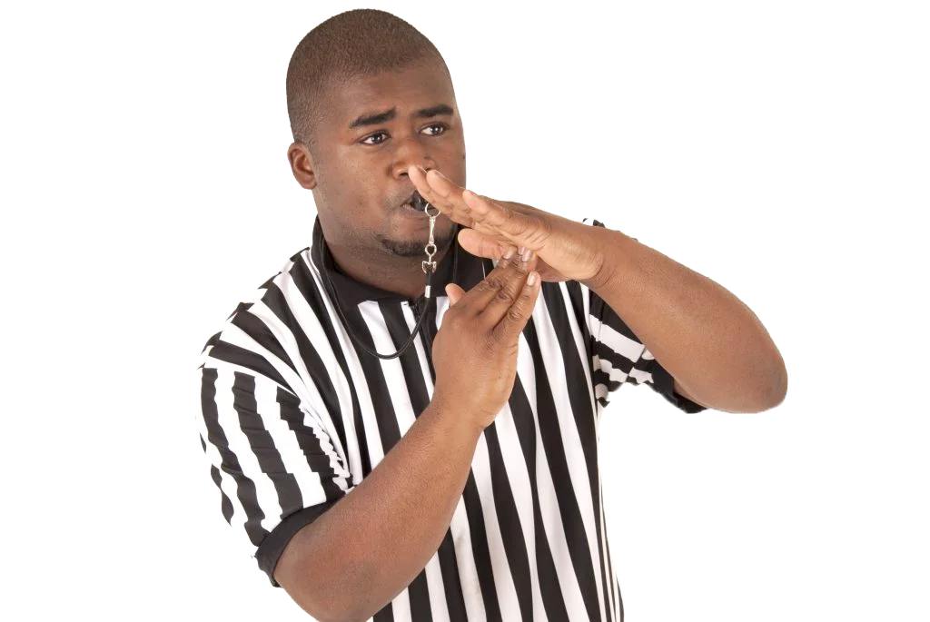
HALF-TIME
ACCRUED LEAVE IS SO YESTERDAY.
NEED TIME OFF TO RECHARGE?
TAKE IT.
HUDDLE WITH YOUR TEAM TO MAKE SURE THEY HAVE YOU COVERED.
PREV
NEXT
Note: with freedom comes responsibility! We're all responsible for results no matter how much time off we take.

Slide 7
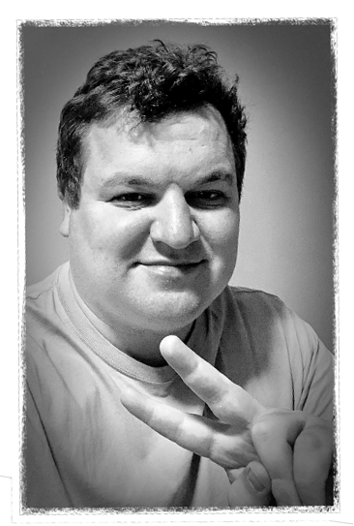
Our CSO Speaks on the
"Race to 10k"
About 6 months ago, after a long day of scouring the internet for Java candidates and planning interviews for potential candidates, our fearless leader, Mark Simons, called the office together at 4:30 for an announcement. Something you will quickly learn working for The Goal, is that, when Mark Simons speaks, everyone listens. When Mark addresses the Reston office, it’s something like a cross between Jordan Belfort addressing his sales team in “The Wolf of Wall Street” and your head coach giving a pep talk before a big game.
This speech was more Belfort than head coach. Mark would be launching a contest; he was calling the “Race to 10K.” The idea was simple, close more deals, and work harder than your colleagues, and The Goal will make you rich. The team bubbled with excitement and anticipation, visions of Jay-Z’s “Big Pimpin” video danced in my head as I planned on how I would spend my bonus. Payouts were announced for 1st, 2nd, and 3rd place for both the sales and recruiting side of the house. As an addition, anyone who hit the 10K bonus, would be added to the next incentive trip (Dominican Republic this year). Immediately the pit went into overdrive, recruiters were working late, coming in on weekends, and watching the leaderboard to see where they ranked among those vying for the 10K bonus.
In the coming months, several Goalies would eclipse the 10K mark in spread growth and announcements would be made, and checks would be written. Some Goalies, like Kyle Roehm, invested their winnings wisely in a blend of stocks and bonds, others like Harold Dill and Brandon Boone, spent lavishly on new suits and exotic vacations. The race has been such a success that Mark issued a statement shortly after the first announcement; this would not be a one-time contest driving a short spike in activity. The “Race to 10K” would be an on-going part of Goalie culture and a rallying cry meant to sharpen focus and effort. Once the winner’s checks were written for 1st, 2nd, and 3rd place, the contest would simply start over and another sprint for 10K spread growth would begin. As the wise man Puff Daddy once said, “It’s all about the Benjamins baby.”
PREV
NEXT

Slide 8
SERIOUS HAT TIME
PREV
NEXT
Seriously!

Slide 9
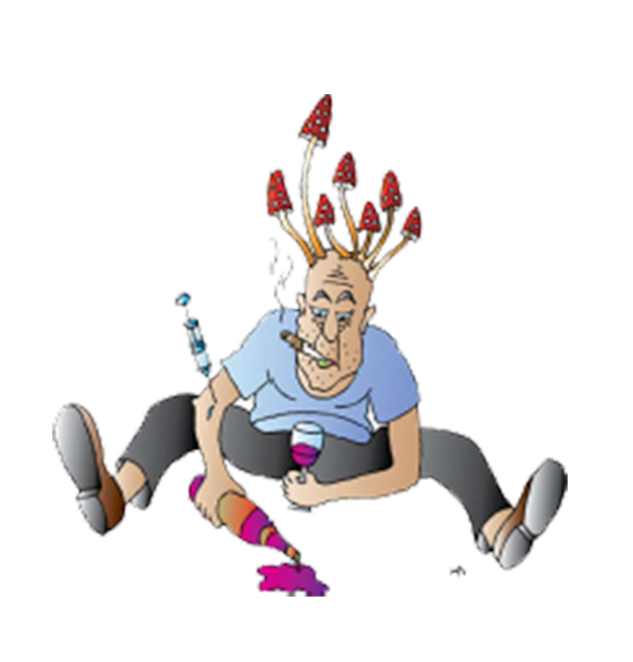
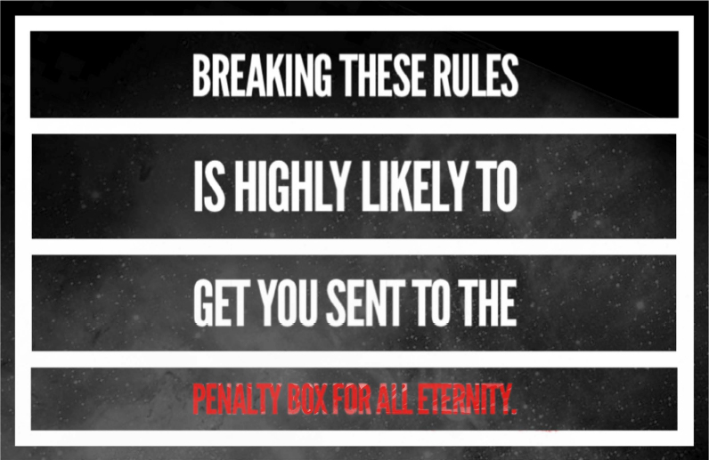
DRUGS
"AT WORK" MEANS THAT YOU ARE ON COMPANY PREMISES OR ENGAGED IN COMPANY BUSINESS. "DRUGS" ARE ILLEGAL CONTROLLED SUBSTANCES, OR PRESCRIPTION SUBSTANCES FOR
WHICH YOU HAVE NO PRESCRIPTION (IN YOUR NAME NOT YOUR GREAT AUNT MARTHA'S NAME).
PREV
NEXT
Basically, don’t
be this guy!

Slide 10
ALCOHOL
THIS ISN'T YOUR TYPICAL WORK PLACE. WE LIKE TO HAVE FUN AND WE TREAT YOU LIKE THE ADULT THAT YOU ARE. WE HAVE ALCOHOL HERE. AND WE LIKE TO RESPONSIBLY PARTAKE IN IT. DON'T DRINK IF YOU'RE NOT OF LEGAL DRINKING AGE. DON'T DRIVE IF YOU HAVE MORE THAN THE LEGAL LIMIT. CALL AN UBER : WE'LL SPLIT THE COST WITH YOU.
PREV
NEXT
How much alcohol is too much?
What if I don't want to drink?
Good question. If you can no longer do your job, make good judgment calls, or treat yourself and the team respectfully, you've gone too far and you're in danger of being permanently benched.
That's awesome! We salute you!

Slide 11
Office Romance
Probably not your best career move.
PREV
IF WE WERE A MAGIC 8-BALL, OUR ANSWER WOULD BE "OUTLOOK NOT SO GOOD". WE'RE NOT GOING TO STOP YOU FROM DOING IT, BUT WE HIGHLY DISCOURAGE IT. THIS IS NOT A TALE BY THE BROTHERS GRIMM, SO YOU CAN'T COUNT ON A HAPPY ENDING. IF YOUR RELATIONSHIP HAS A NEGATIVE IMPACT ON OUR TEAM, ONE OR BOTH OF YOU WILL BE PERMANENTLY BENCHED.
WE DON'T NEED AN 8-BALL FOR THIS ONE. IT IS NEVER ACCEPTABLE FOR A COACH TO BECOME INVOLVED WITH SOMEONE ON THEIR TEAM. IF YOU FANCY YOURSELVES TO BE THE NEXT BRANGELINA, YOU GUYS ARE GONNA HAVE TO HUDDLE AND MAKE A DECISION ABOUT WHICH ONE OF YOU WILL BE LEAVING US. IF YOU CAN'T, WE'LL HAVE TO MAKE THE CALL... AND THAT WOULD REALLY SUCK.
NEXT
Eh…
Nope!

Slide 12
LET’S ROLL
This playbook does not constitute an employment contract or binding policy and is subject to change at any time either goal or an employee can terminate the employment relationship at any time, with or without cause, with or without notice. Employment with the goal is at-will, and nothing in this playbook will alter that status.
PREV

